Slide 1
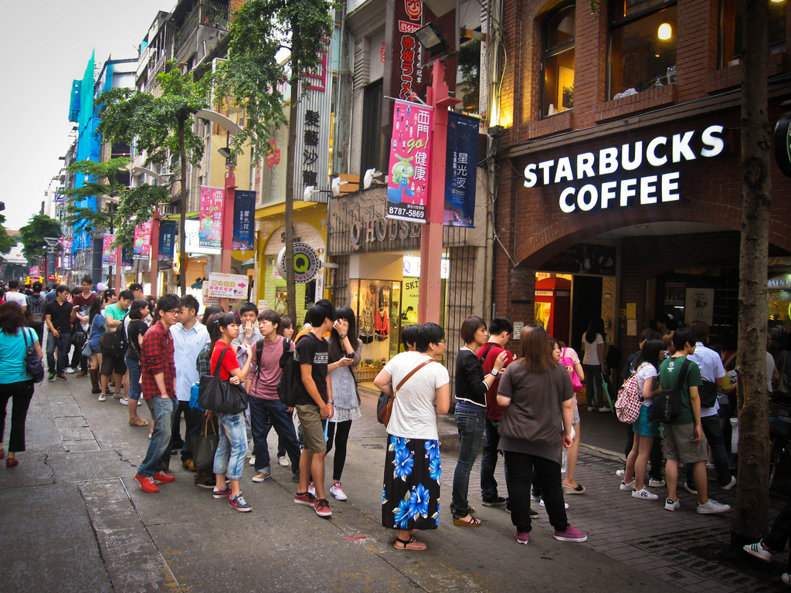
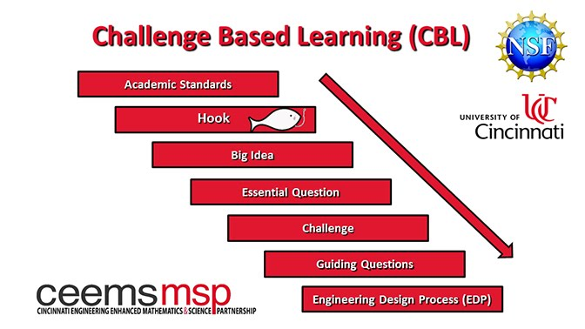
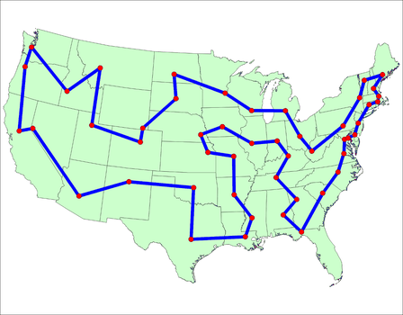
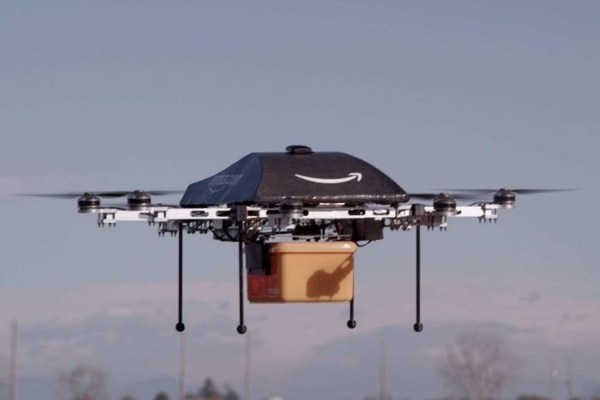
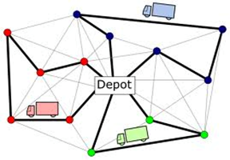
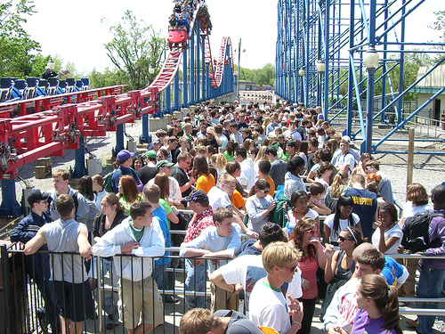
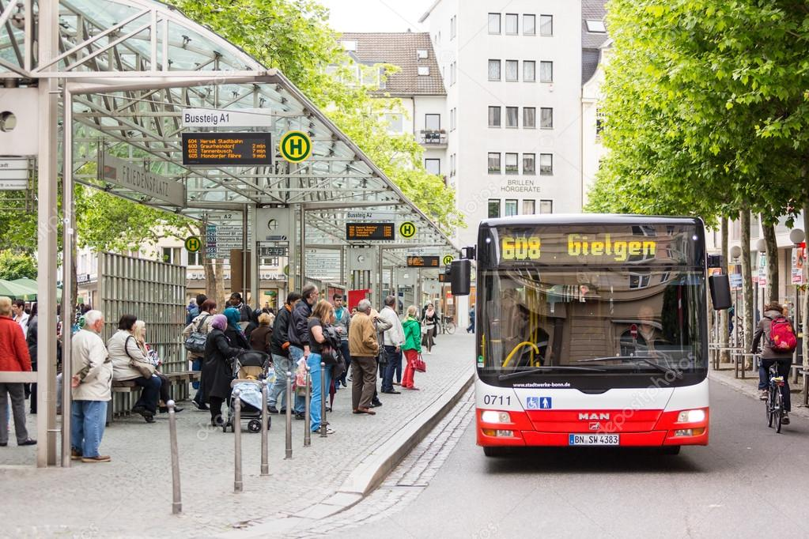
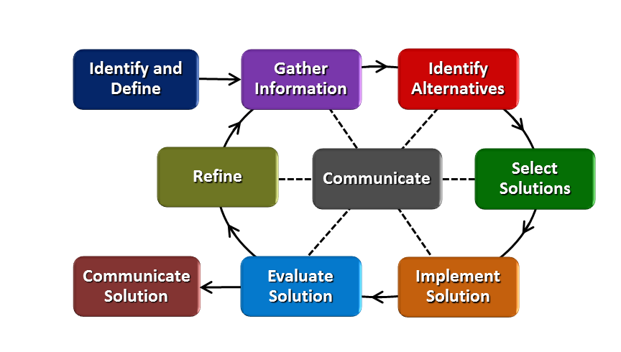
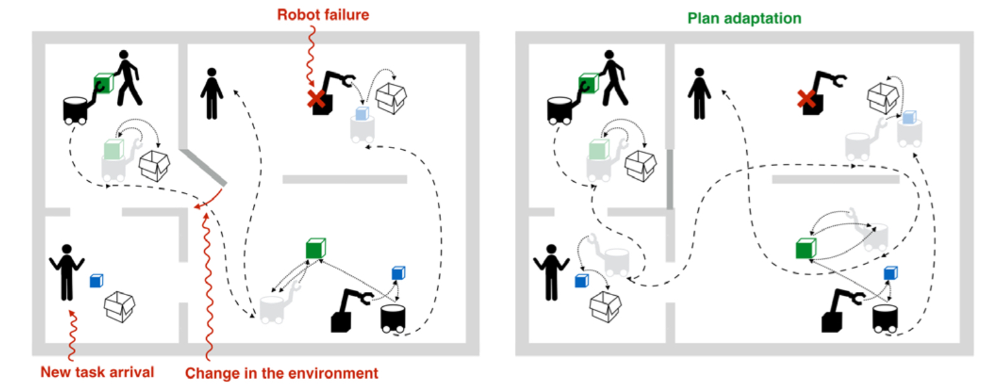
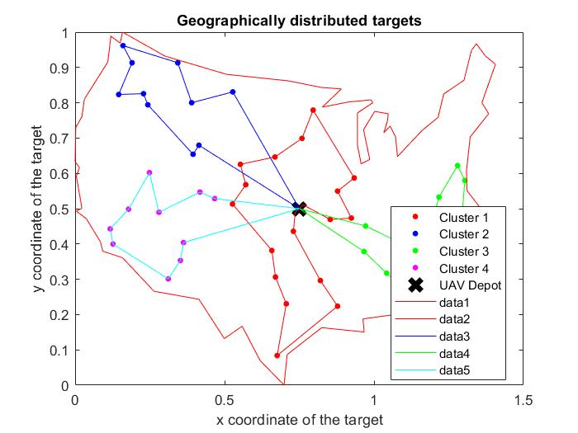
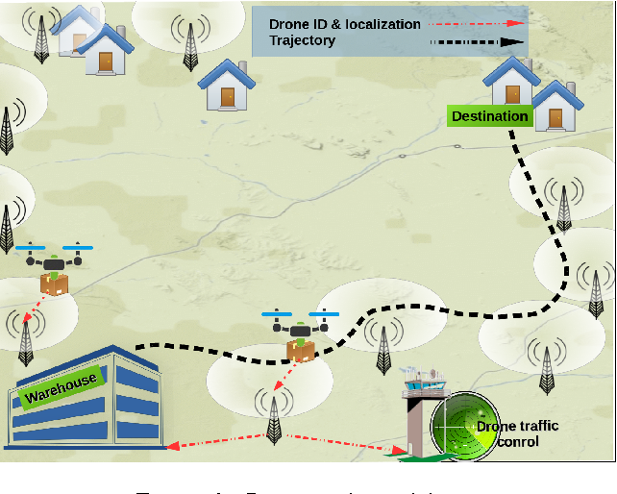
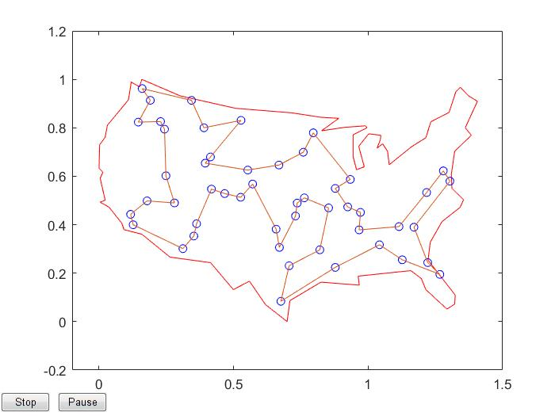
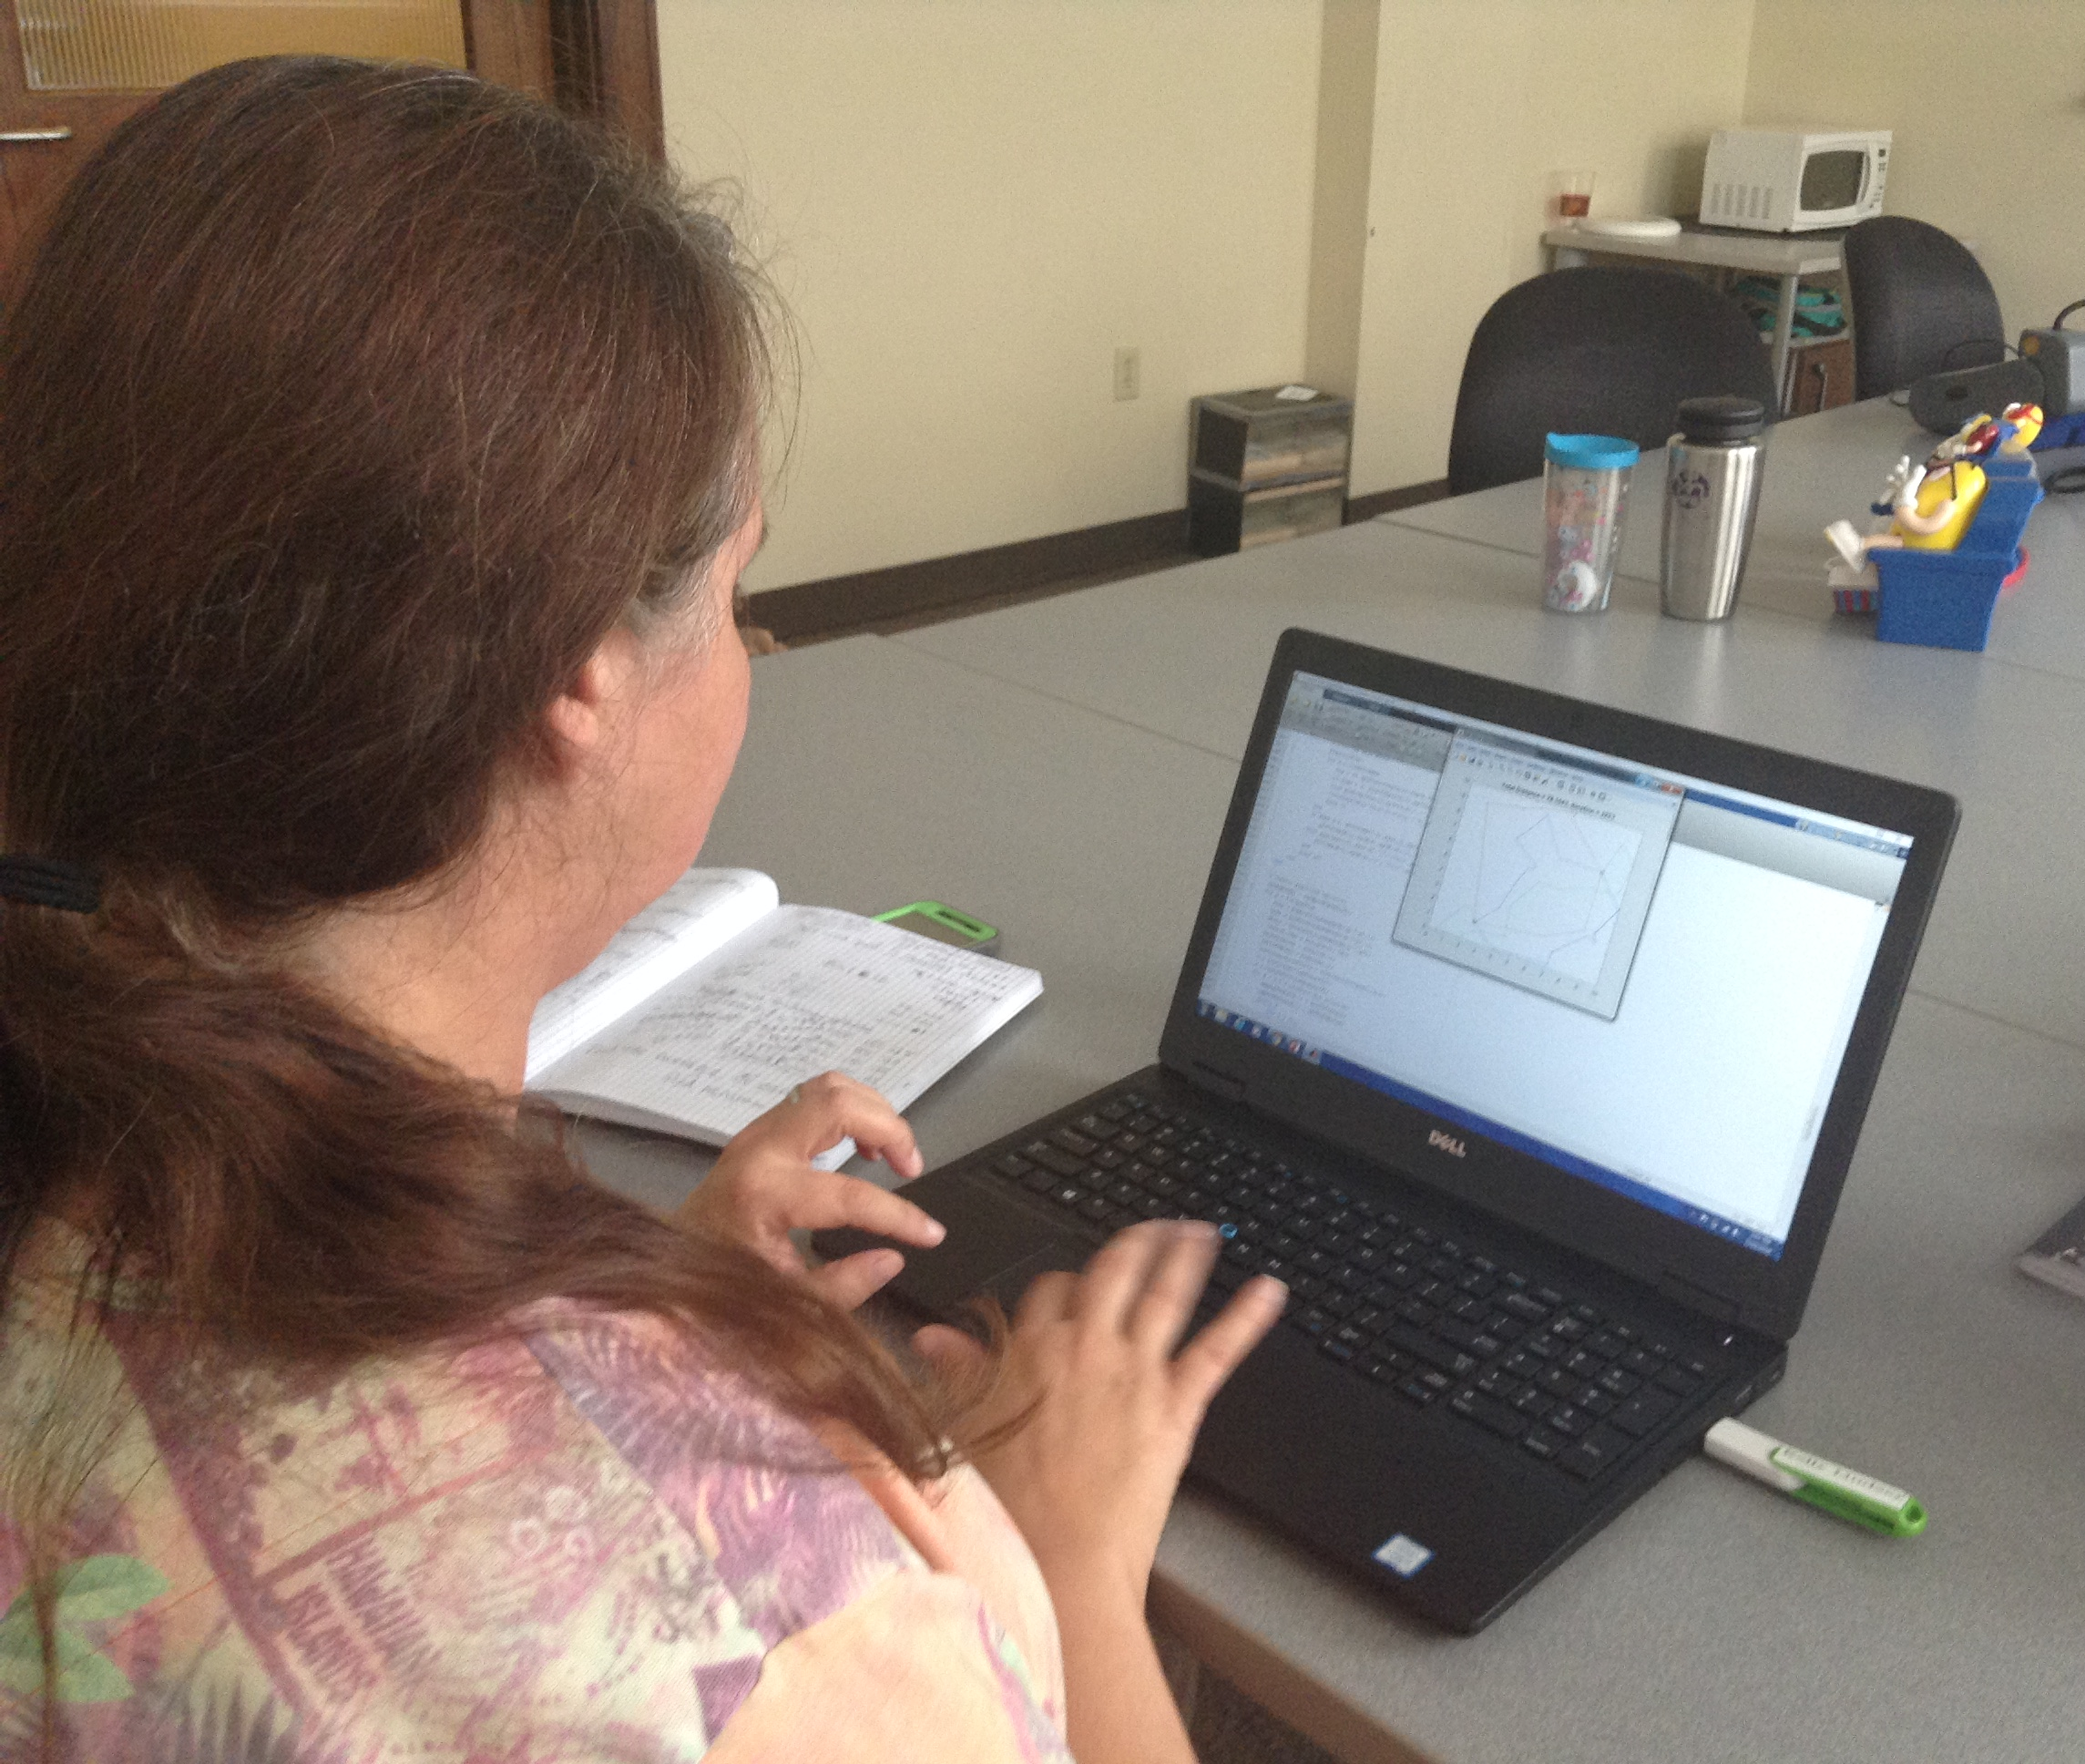
Optimizing Our World Beth Francis Felicity Franklin Schools, Gifted STEM Grades 3-8
RET is funded by the National Science Foundation, grant # EEC-1710826
Summer Research
Classroom Implementation
Why Optimization
Bio-Inspired Optimization of the Multiple Traveling Salesman Problem
Student led
Real world problem solving and application
Collaborative team learning
Increases 21st century skills
Through the Engineering Design Process students learn the importance of:
Research and Testing
Communication and Teamwork
Refining Ideas
Identifying Alternative Solutions
.
Bio-Inspired Optimization of the Multiple Traveling Salesman Problem
Challenge Based Learning
How do you feel
about waiting in line?
https://c1.staticflickr.com/7/6136/5929178282_761046f7b7_b.jpg
www.solver.com/solver-platform-sdk-source-code-examples
http://www.abc.net.au/news/image/8123084-3x2-700x467.jpg
www.rcasts.com/2010/11/any-r-packages-to-solve-vehicle-routing.html
How can we spend less time in line and more time having fun?
Goals and Objectives
Understand
MATLAB Coding
Test Algorithms
NN, 2-Opt, GA
Refine
Test Modified GA against 2-Opt and MATLAB GA
Traveling Salesman Problem
Use clustering with a depot to test GA for MTSP
Optimization Algorithms
http://newvaluestreams.com/wordpress/wp-content/uploads/2008/11/long-lines.jpg
How can we avoid these lines?
Engineering Design Process
Research In Action
https://st.depositphotos.com/1000315/4616/i/950/depositphotos_46166383-stock-photo-bonn-germany-may-6-2014.jpg
Drone Lab
What is path planning?
https://www.kth.se/polopoly_fs/1.775470!/image/plan.jpg
MATLAB
Could this be the
future of package delivery?
https://ai2-s2-public.s3.amazonaws.com/figures/2017-08-08/8d4b904e61f95dfe1b81fe90ca56e284a8d30e94/2-Figure1-1.png

